Slide 1
Mobile Computing
Cellular concepts

Slide 2
Introduction
Early mobile radio system
Large coverage area by using a single, high power transmitter.
No frequency reuse.
Cellular Concept
A System level idea.
Large cell is divided into many small cells.
Each base stations are assigned different groups of channels.
Neighboring base stations are assigned different groups of channels.
Interference is minimized.
On demand increase the number of base stations with different channel groups.

Slide 3
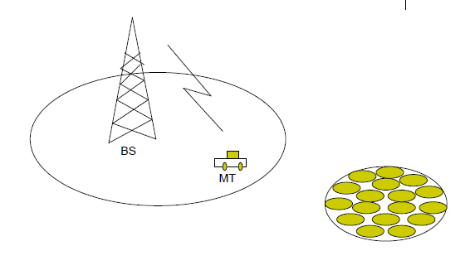
Contnd…

Slide 4
Cellular Concept
Why not a large radio tower and large service area?
– Number of simultaneous users would be very limited
(to total number of traffic channels T)
– Mobile handset would have greater power requirement
Cellular concept - small cells with frequency reuse
– Advantages
• lower power handsets
• Increases system capacity with frequency reuse
– Drawbacks:
• Cost of cells
• Handoffs between cells must be supported
• Need to track user to route incoming call/message

Slide 5
Frequency Reuse
Cells
Base station antennas designed to cover specific geographical area
Allocated a group of radio channels
Hexagonal cell shape assumed for planning
Simple model for easy analysis → circles leave gaps
Actual cell “footprint” is amorphous (no specific shape)

Slide 6
Contnd..
Base station location
Center Excited → omni-directional antenna (360° coverage)
Not necessarily in the exact center (can be up to R/4 from the ideal location)
Corner Excited → sectored or directional antennas on 3 corners with 120° coverage.
Very commom
Note that what is defined as a “corner” is somewhat flexible → a sectored antenna covers 120° of a hexagonal cell.
So one can define a cell as having three antennas in the center or antennas at 3 corners.

Slide 7
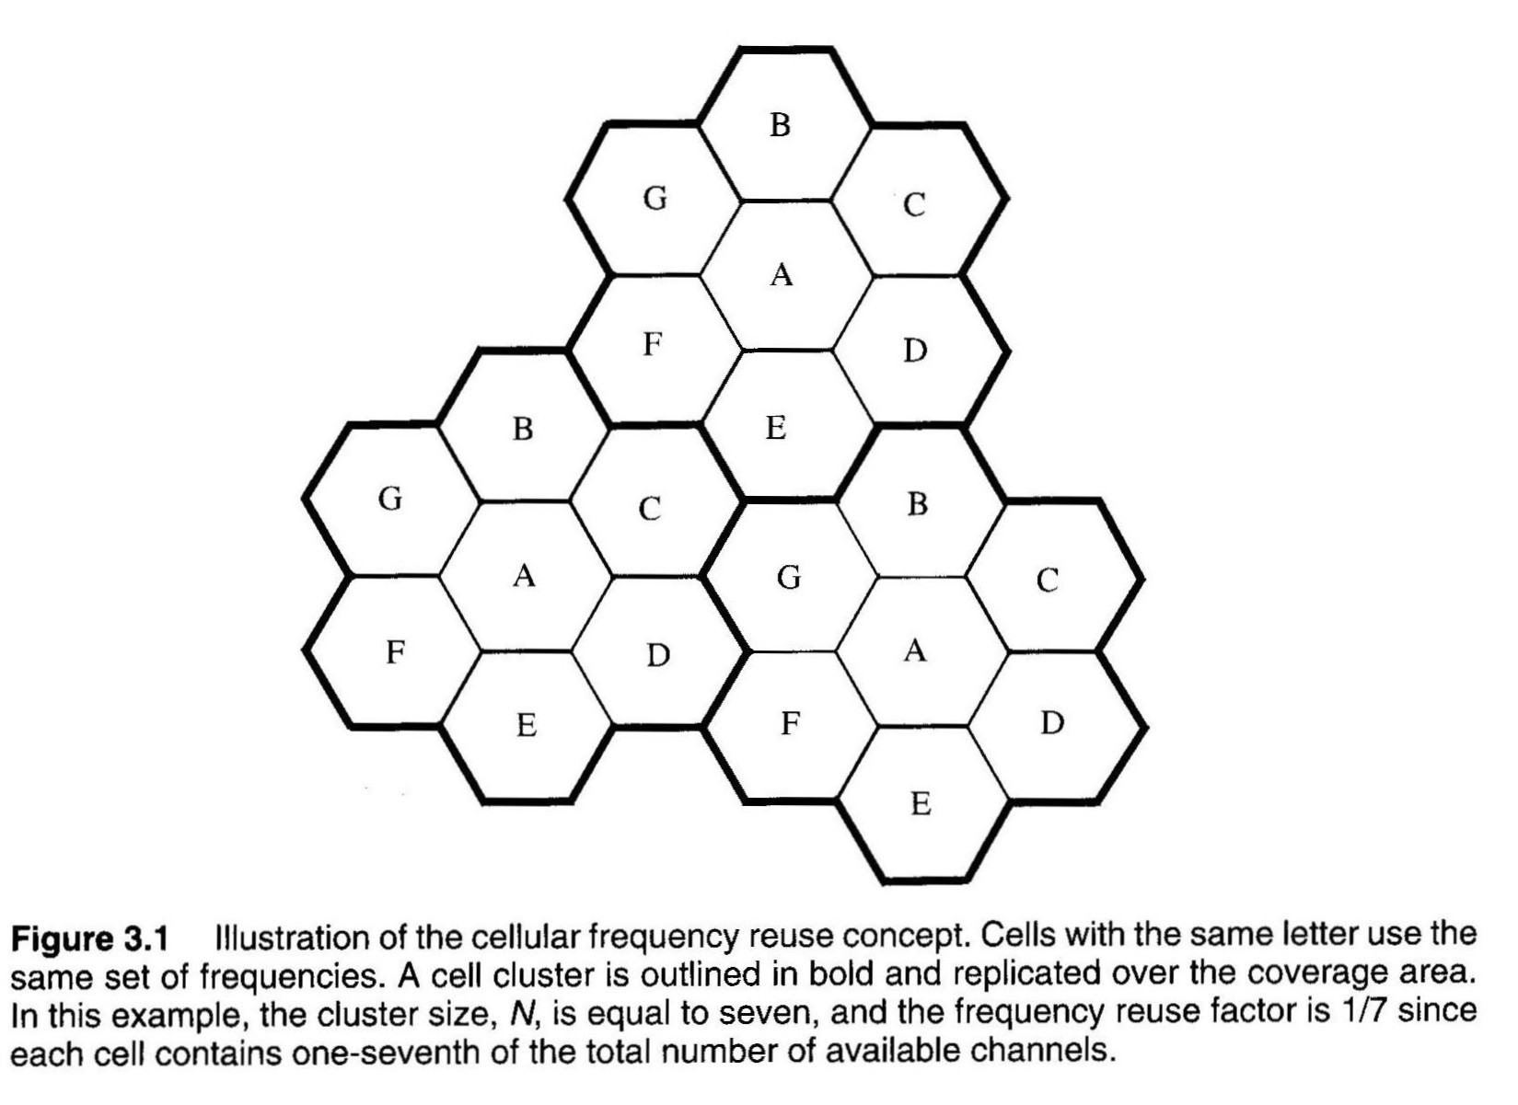
Frequency Reuse

Slide 8
Contnd..
Cells labeled with the same letter use the same group of channels.
Cell Cluster:
Group of N cells using complete set of available channels
Many base stations, lower power, and shorter towers
Each cell allocated a % of the total number of available channels
Nearby (adjacent) cells assigned different channel groups
To prevent interference between neighboring base stations and mobile users

Slide 9
System Capacity
S : total # of duplex channels available for use in a given area; determined by:
amount of allocated spectrum
channel BW → modulation format and/or standard specs. (e.g. AMPS)
k : number of channels for each cell (k < S)
N : cluster size → # of cells forming cluster
S = k N
M : # of times a cluster is replicated over a geographic coverage area
System Capacity = Total # Duplex Channels = C
C = M S = M k N
(assuming exactly MN cells will cover the area)

Slide 10
Contnd..
If cluster size (N) is reduced and the geographic area for each cell is kept constant:
The geographic area covered by each cluster is smaller, so M must ↑ to cover the entire coverage area (more clusters needed).
S remains constant.
So C ↑
The smallest possible value of N is desirable to maximize system capacity.

Slide 11
Contnd..
Cluster size N determines:
Distance between co-channel cells (D)
Level of co-channel interference
A mobile or base station can only tolerate so much interference from other cells using the same frequency and maintain sufficient quality.
Large N → large D → low interference → but small M and low C !
Tradeoff in quality and cluster size.
The larger the capacity for a given geographic area, the poorer the quality.

Slide 12
Contnd..
Frequency reuse factor = 1 / N
Each frequency is reused every N cells
Each cell assigned k = S / N
N cells/cluster
Connect without gaps
Specific values are required for hexagonal geometry
N = i² + i j + j² where i, j ≧ 0
Typical N values → 3, 4, 7, 12; (i, j) = (1,1), (2,0), (2,1), (2,2)

Slide 13
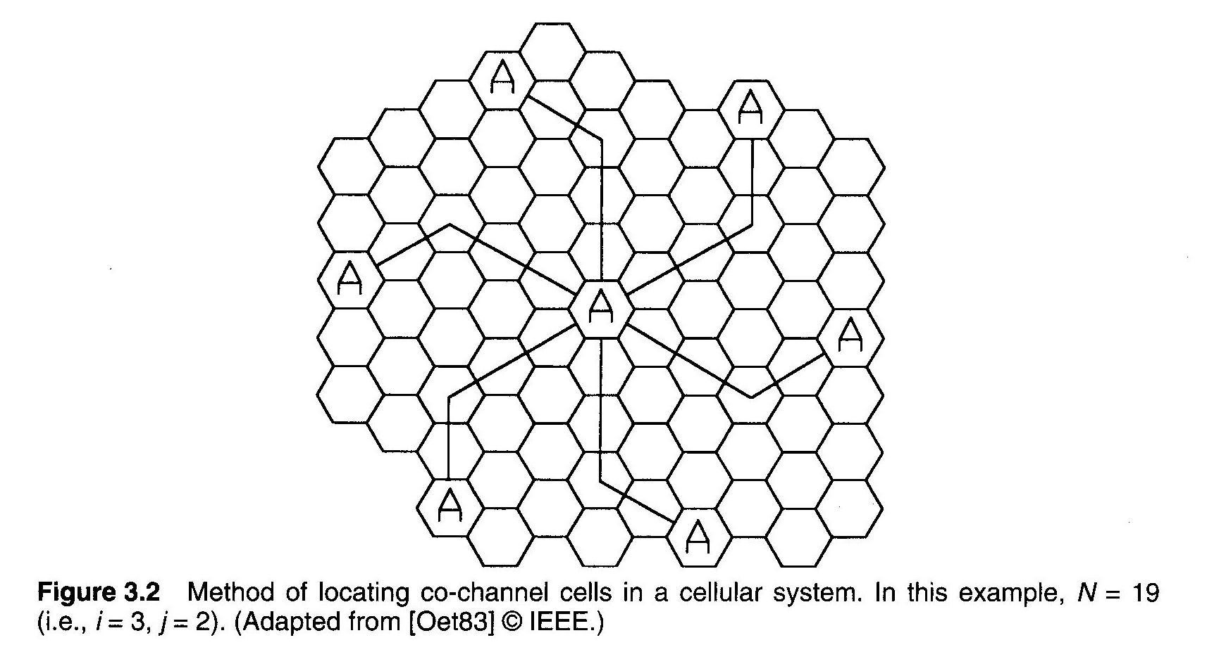
To find the nearest co-channel neighbors of a particular cell
(1) Move i cells along any chain of hexagons, then (2) turn 60 degrees and move j cells.

Slide 14
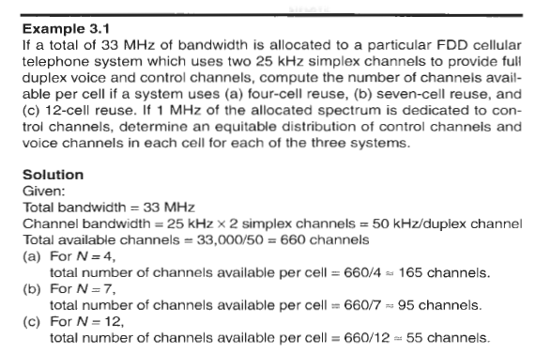
Example

Slide 15
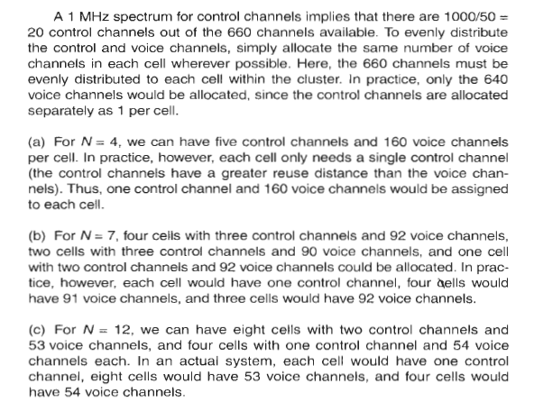

Slide 16
Channel Assignment Strategies
Goal is to minimize interference & maximize use of capacity
Impacts the performance of the system
Cell management, hand off management.
Two main strategies: Fixed or Dynamic
Fixed
Each cell allocated a pre-determined set of voice channels
Calls within cell only served by unused cell channels
All channels used → blocked call → no service
Several variations: Eg- Borrowing strategy:
MSC allows cell to borrow channels from an adjacent cell
Does not disrupt or interfere with any ongoing calls in the donor cell.
Notes:
MSC- mobile switching center

Slide 17
Contnd..
Dynamic
Channels NOT allocated permanently
Call request → goes to serving base station → goes to MSC
MSC allocates channel “on the fly”
Allocation strategy considers:
Likelihood of future call blocking in the cell
Reuse distance (interference potential with other cells that are using the same frequency)
Channel usage frequency
All frequencies in a market are available to be used

Slide 18
Contnd..
Advantage: reduces call blocking, and increases voice quality
Disadvantage: increases storage & computational load @ MSC
Requires real-time data from entire network related to:
Channel occupancy
Traffic distribution
Radio Signal Strength Indications from all channels

Slide 19
Handoff Strategies
Handoff: when a mobile unit moves from one cell to another while a call is in progress, the MSC must transfer (handoff) the call to a new channel belonging to a new base station
New voice and control channel frequencies
Very important task → often given higher priority than new call
It is worse to drop an in-progress call than to deny a new one.

Slide 20
Contnd..
Must be performed successfully and as infrequently as possible, and be imperceptible to the users.
Minimum useable signal level
Lowest acceptable voice quality
Call is dropped if below this level
Specified by system designers
Typical values → -90 to -100 dBm

Slide 21
Contnd..
Choose a (handoff threshold) > (minimum useable signal level)
So there is time to switch channels before level becomes too low
As mobile moves away from base station and toward another base station

Slide 22
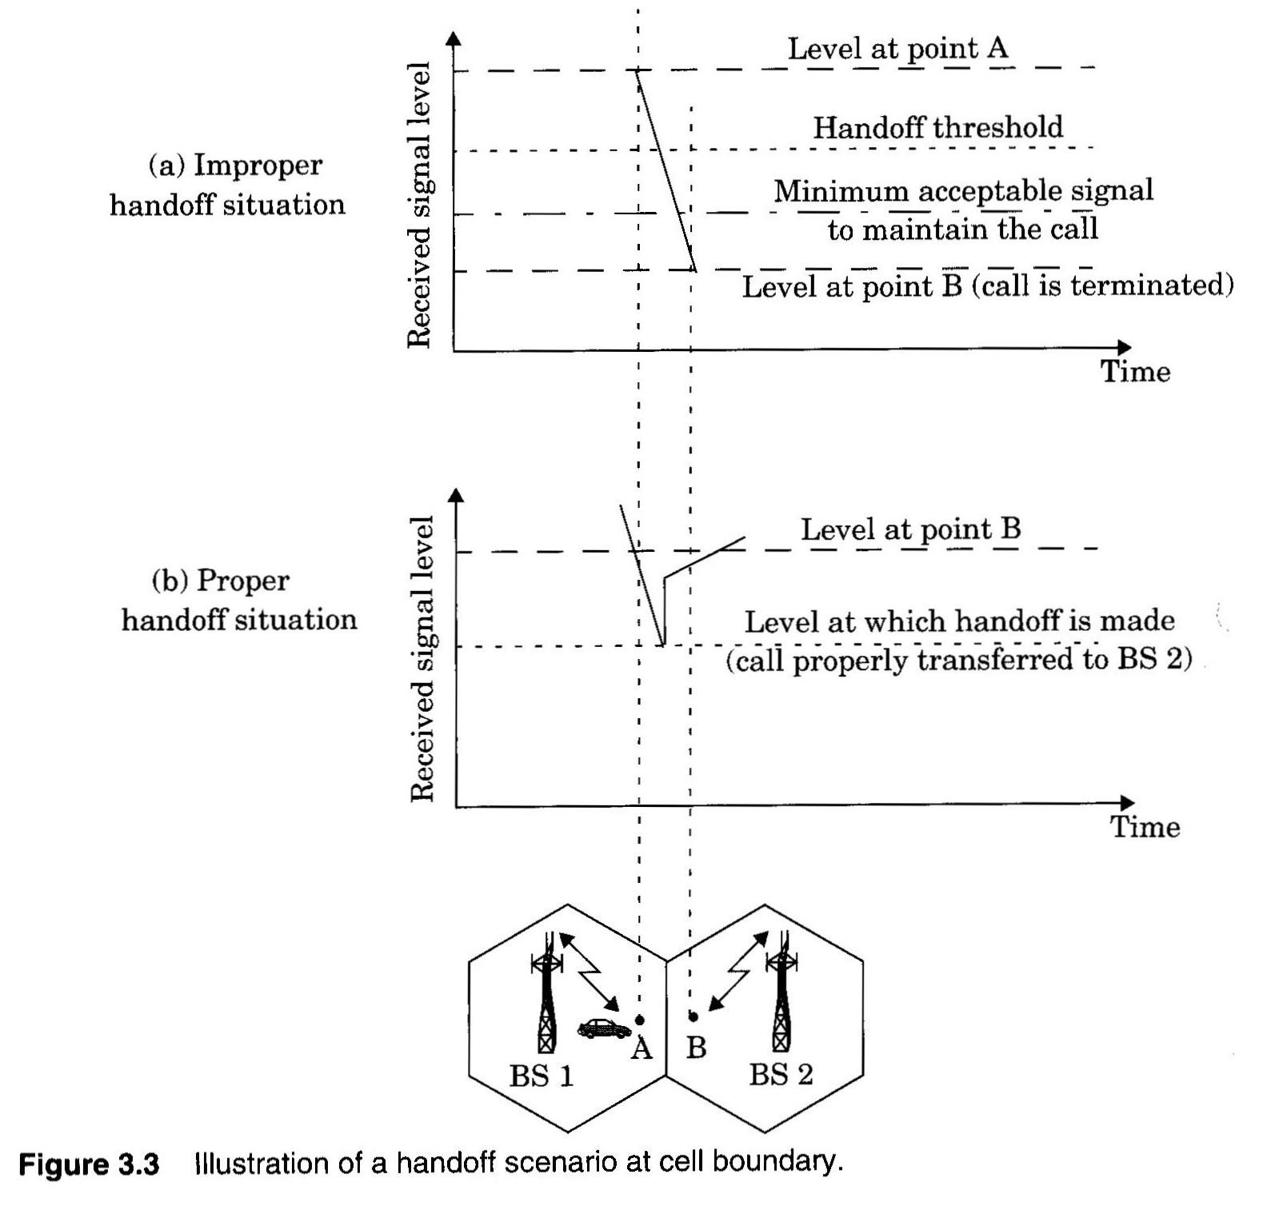

Slide 23
Contnd..
Handoff Margin △
△ = P_{handoff threshold} - P_{minimum} _{usable signal} dB
Carefully selected
△ too large → unnecessary handoff → MSC loaded down
△ too small → not enough time to transfer → call dropped!
A dropped handoff can be caused by two factors
Not enough time to perform handoff
Delay by MSC in assigning handoff
High traffic conditions and high computational load on MSC can cause excessive delay by the MSC
No channels available in new cell

Slide 24
Contnd..
Handoff Decision
Signal level decreases due to
signal fading → don’t handoff
Mobile moving away from base station → handoff
Must monitor received signal strength over a period of time → moving average
Time allowed to complete handoff depends on vehicle speed
High speed → quick handoff
Statistics of the fading signal are important to making appropriate handoff decisions.

Slide 25
Contnd..
Dwell time
The time over which a call may be maintained within a cell, without handoff.
Governing factors
Propagation, interference, distance between the subscriber and the base station, and other time varying effects.
A stationary subscriber may have a random and finite dwell time.

Slide 26
Contnd..
1st Generation Cellular (Analog FM → AMPS)
Signal strength measurements are made by the base stations and supervised by the MSC.
Base station constantly monitors the signal strengths of all of its reverse voice channels.
To determine the relative location of each mobile user with respect to the base station tower.
Received signal strength (RSS) measured at base station & monitored by MSC
A spare Rx in base station (locator Rx) monitors RSS of users in neighboring cells
Tells Mobile Switching Center about these mobiles and their channels
Locator Rx can see if signal to this base station is significantly better than to the host base station
MSC monitors RSS from all base stations & decides on handoff

Slide 27
Contnd..
2nd Generation Cellular w/ digital TDMA (GSM, IS-136)
Mobile Assisted HandOff (MAHO)
Important advancement
The mobile measures the RSS of the adjacent base stations & reports back to serving base station
If Rx power from new base station > Rx power from serving (current) base station by pre-determined margin for a long enough time period → handoff initiated by MSC

Slide 28
Contnd..
MSC no longer monitors RSS of all channels
Reduces computational load considerably
Enables much more rapid and efficient handoffs
Imperceptible to user
More suited for microcellular environments.

Slide 29
Contnd..
Intersystem Handoff
A mobile may move into a different system controlled by a different MSC.
When a mobile signal becomes weak in a given cell and the MSC cannot find another cell within its system to which it can transfer the call in progress.
Issues
A local call may become a long-distance call as the mobile moves out of its home system and becomes a roamer in a neighbouring system.
Compatibility between the two MSCs must be determined before implementing an intersystem handoff

Slide 30
Prioritizing Handoffs
Issue: Perceived Grade of Service (GOS) – service quality as viewed by users
“quality” in terms of dropped or blocked calls (not voice quality)
assign higher priority to handoff vs. new call request
a dropped call is more aggravating than an occasional blocked call

Slide 31
Contnd..
Guard Channels
% of total available cell channels exclusively set aside for handoff requests
Makes fewer channels available for new call requests
A good strategy is dynamic channel allocation (not fixed)
Adjust number of guard channels as needed by demand
So channels are not wasted in cells with low traffic

Slide 32
Contnd..
Queuing Handoff Requests
Use time delay between handoff threshold and minimum useable signal level to place a blocked handoff request in queue
A handoff request can "keep trying" during that time period, instead of having a single block/no block decision
Prioritize requests (based on mobile speed) and handoff as needed
Calls will still be dropped if time period expires

Slide 33
Practical Handoff Considerations
Problems occur because of a large range of mobile velocities
pedestrian vs. vehicle user
Small cell sizes and/or micro-cells → larger # handoffs
MSC load is heavy when high speed users are passed between very small cells.

Slide 34
Contnd..
Umbrella Cells
Use different antenna heights and Tx power levels to provide large and small cell coverage
Multiple antennas & Tx can be co-located at single location if necessary (saves on obtaining new tower licenses)
Large cell → high speed traffic → fewer handoffs
Small cell → low speed traffic.

Slide 35
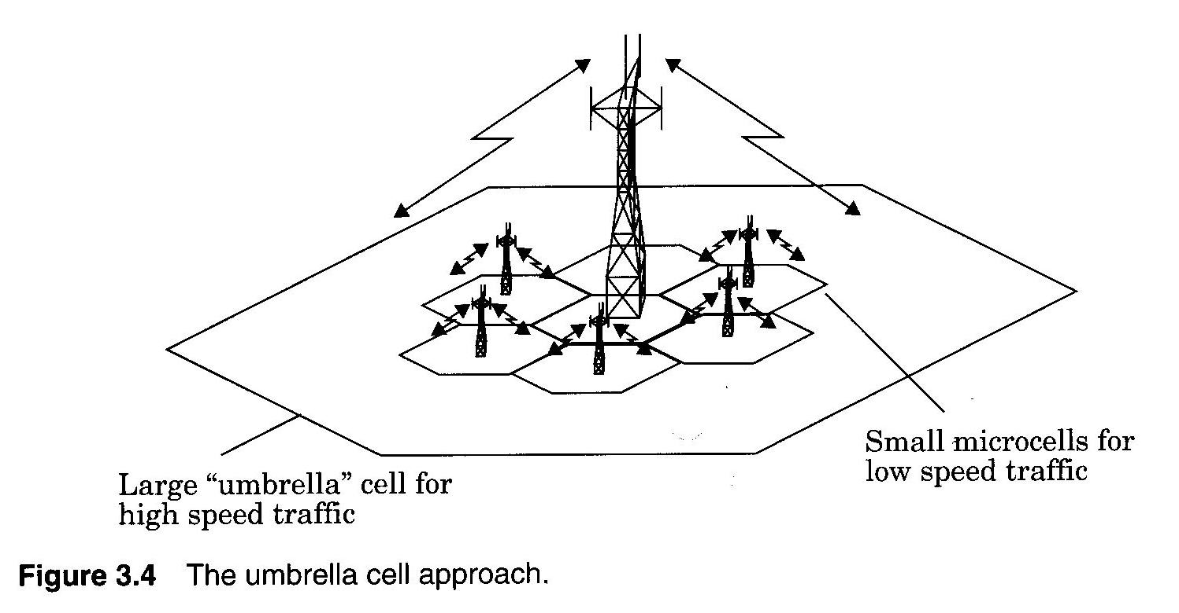

Slide 36
Contnd..
The speed of each user may be estimated
By the base station or MSC
by evaluating how rapidly the short-term average signal strength on the RVC changes over time,
or more sophisticated algorithms may be used to evaluate and partition users.
If a high speed user in the large umbrella cell is approaching the base station, and its velocity is rapidly decreasing,
The base station may decide to hand the user into the co-located microcell, without MSC intervention.

Slide 37
Contnd..
Cell Dragging
Low speed user when in line of sight to base station (very strong signal)
Strong signal changing slowly
User moves into the area of an adjacent cell without handoff
Causes interference with adjacent cells and other cells
Handoff thresholds and radio coverage parameters must be adjusted carefully.

Slide 38
Contnd..
Typical handoff parameters
Analog cellular (1st generation)
Threshold margin △ ≈ 6 to 12 dB
Total time to complete handoff ≈ 8 to 10 sec
Digital cellular (2nd generation)
Total time to complete handoff ≈ 1 to 2 sec
Lower necessary threshold margin △ ≈ 0 to 6 dB
Enabled by mobile assisted handoff

Slide 39
Contnd..
Benefits of small handoff time
Greater flexibility in handling high/low speed users
Queuing handoffs & prioritizing
More time to “rescue” calls needing urgent handoff
Fewer dropped calls.
Can make decisions based on a wide range of metrics other than signal strength
Such as the measure of interference levels
Can have a multidimensional algorithm for making decisions

Slide 40
Soft vs. Hard Handoffs
Hard handoff: Different radio channels assigned when moving from cell to cell
all analog (AMPS) & digital TDMA systems (IS-136, GSM, etc.)
Soft Handoff: Many spread spectrum users share the same frequency in every cell
CDMA → IS-95
Since a mobile uses the same frequency in every cell, it can also be assigned the same code for multiple cells when it is near the boundary of multiple cells.
The MSC simultaneously monitors reverse link signal at several base stations

Slide 41
MSC dynamically decides which signal is best and then listens to that one
Passes data from that base station on to the PSTN
This choice of best signal can keep changing.
Mobile user does nothing for handoffs except just transmit, MSC does all the work
Advantage unique to CDMA systems
As long as there are enough codes available.

